Slide 1
Building a machine learning model
Xiantong Wang
CLaSP

Slide 2
Contents
Before getting started
Keras – A high level API of Tensorflow
PyTorch – A flexible framework, good for research prototyping
Hardware

Slide 3
Before Getting Started
Abstract your task
What data you have?
Feature engineering

Slide 4

Abstract your task
Classification:
Binary/Multiclass classification
Risk control; cyber security; image recognition…
Regression
High dimensional fitting
Stock price forecasting
Others
Tagging
Unsupervised learning

Slide 5
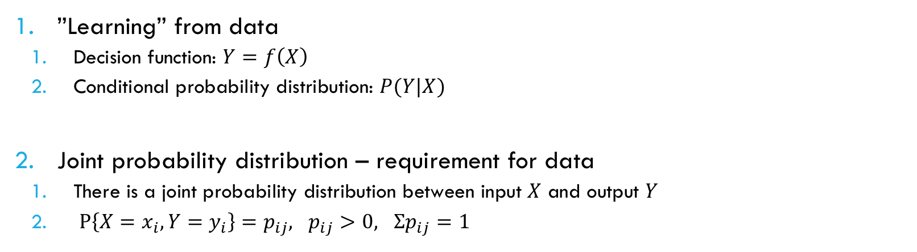
What data you have?
”Learning” from data
Decision function: $Y=f\left(X\right)$
Conditional probability distribution: $P(Y|X)$
Joint probability distribution – requirement for data
There is a joint probability distribution between input $X$ and output $Y$
$P\left\{X=x_{i}, Y=y_{i}\right\}=p_{ij}, p_{ij}>0, Σp_{ij}=1$

Slide 6
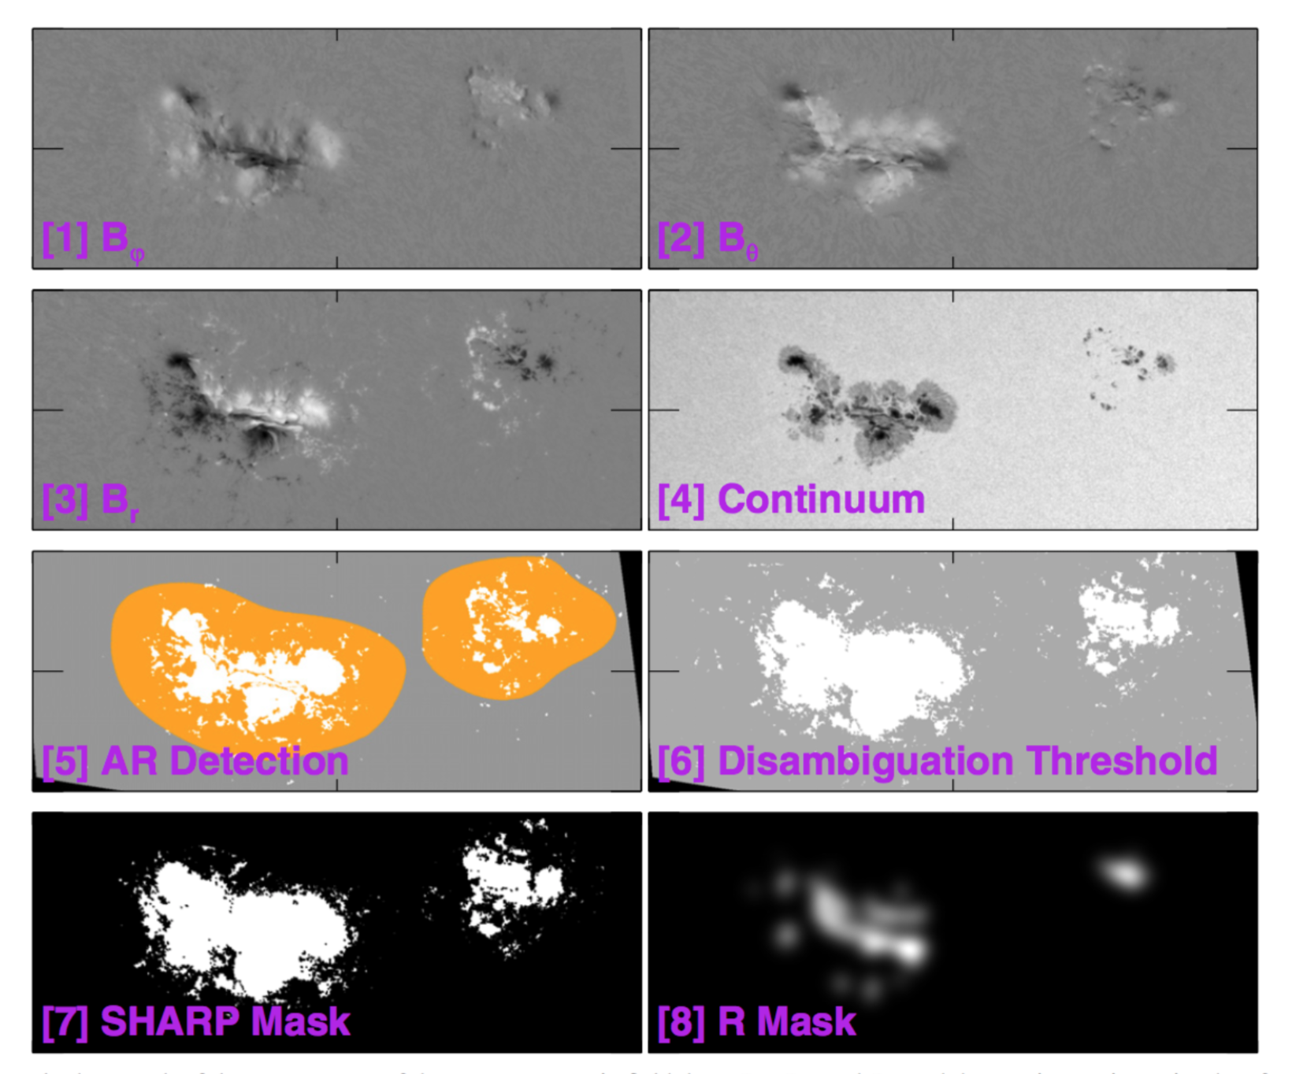
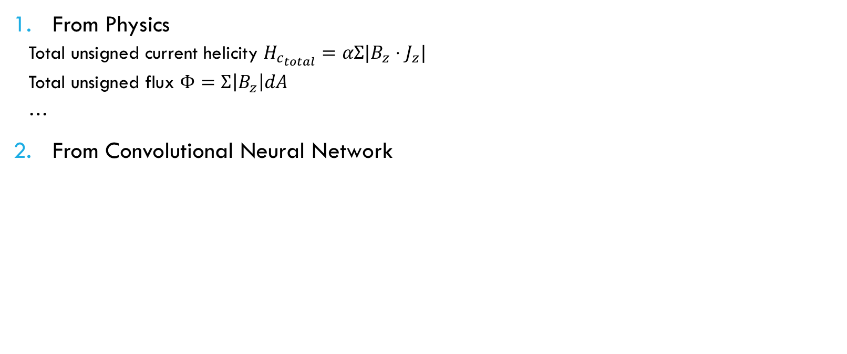
Feature engineering
From Physics
Total unsigned current helicity $H_{c_{total}}=αΣ|B_{z}⋅J_{z}|$
Total unsigned flux $Φ=Σ\left|B_{z}\right|dA$
…
From Convolutional Neural Network
M. G. Bobra et al., 2015

Slide 7
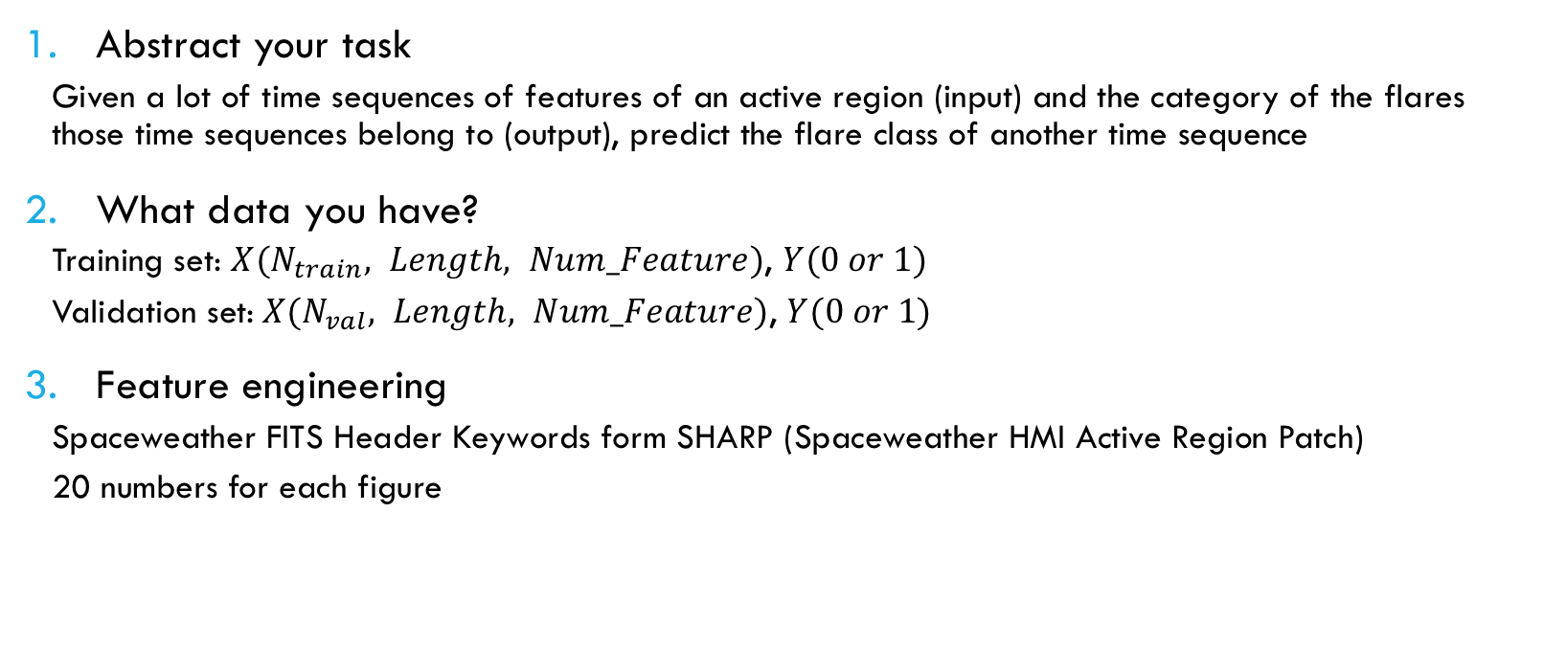
Time sequence classification – Solar Flare prediction Task
Abstract your task
Given a lot of time sequences of features of an active region (input) and the category of the flares those time sequences belong to (output), predict the flare class of another time sequence
What data you have?
Training set: $X(N_{train}, Length, Num_Feature)$, $Y(0 or 1)$
Validation set:$X(N_{val}, Length, Num_Feature)$, $Y(0 or 1)$
Feature engineering
Spaceweather FITS Header Keywords form SHARP (Spaceweather HMI Active Region Patch)
20 numbers for each figure

Slide 8
Build a LSTM sequence classification model using KERas
Keras is a high-level neural networks API, written in Python and capable of running on top of TensorFlow, CNTK, or Theano. It was developed with a focus on enabling fast experimentation.
Prepare the data (Numpy Array)
Coding the model
Train the model
Evaluate the model, parameter tuning

Slide 9
Coding the model
file models.py:
from keras.models import Sequential
from keras.layers import Dense, Dropout, LSTM
def LSTM_User(num_period, num_features):
model = Sequential()
model.add(LSTM(50, return_sequences=True, input_shape=(num_period, num_features))) model.add(Dropout(0.5))
model.add(LSTM(50))
model.add(Dropout(0.5))
model.add(Dense(1, activation='sigmoid’))
model.compile(loss='binary_crossentropy', optimizer='adam', metrics=['accuracy’])
return model

Slide 10
Train the model
file train.py:
from models import LSTM_User
from keras.models import load_model
from keras.backend import clear_session
model = LSTM(num_period, num_feature)
history = model.fit(X_train, y_train, validation_data=(X_test, y_test), epochs=8, batch_size=10)
y_pred_sw = model.predict(X_test)
# save and load the model for future use
model.save("model.h5")
model = load_model('model.h5’)
clear_session()

Slide 11
Evaluate the model
from sklearn.metrics import roc_curve, confusion_matrix, auc
y_pred = model.predict(X_test)
fpr, tpr, threshold = roc_curve(y_test, y_pred)
auc = auc(fpr, tpr)
y_pred[y_pred < 0.5] = 0
y_pred[y_pred >= 0.5] = 1
tn, fp, fn, tp = confusion_matrix(y_test, y_pred).ravel()

Slide 12
Build a LSTM sequence classification model using Pytorch
PyTorch is a Python-based scientific computing package targeted at two sets of audiences:
A replacement for NumPy to use the power of GPUs
A deep learning research platform that provides maximum flexibility and speed

Slide 13
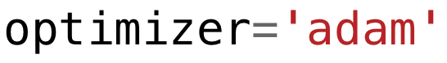
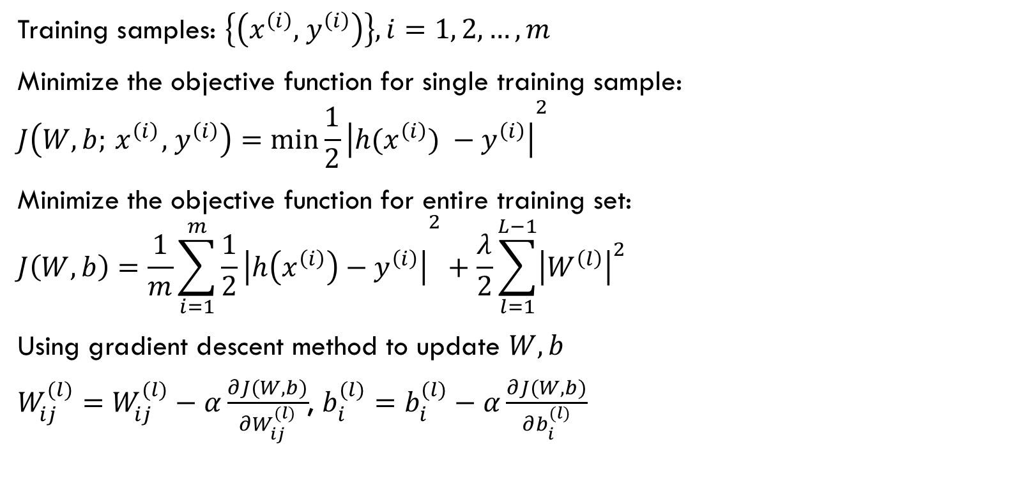
What’s inside the model.fit? – Backward propagation
Training samples: $\left\{\left(x^{\left(i\right)},{ y}^{\left(i\right)}\right)\right\}, i=1, 2, …, m$
Minimize the objective function for single training sample:
$$J\left(W, b;{ x}^{\left(i\right)},{ y}^{\left(i\right)}\right)={\min{\frac{1}{2}\left|h(x^{\left(i\right)}) −{ y}^{\left(i\right)}\right|}}^{2}$$
Minimize the objective function for entire training set:
$$J\left(W, b\right)=\frac{1}{m}{\sum_{i=1}^{m}{\frac{1}{2}\left|h\left(x^{\left(i\right)}\right)−{ y}^{\left(i\right)}\right|}}^{2}+\frac{λ}{2}\sum_{l=1}^{L−1}{{\left|W^{\left(l\right)}\right|}^{2}}$$
Using gradient descent method to update $W, b$
$W_{ij}^{(l)}=W_{ij}^{(l)}−α\frac{∂J(W, b)}{∂W_{ij}^{(l)}}$, $b_{i}^{(l)}=b_{i}^{(l)}−α\frac{∂J(W, b)}{∂b_{i}^{(l)}}$
(Not binary crossentropy in the equation)
(Not adam optimizer in the equation)

Slide 14
Pytorch training code
import torch
from model import LSTM_Classification
from MyDataset import MyDataset
# CUDA for PyTorch
use_cuda = torch.cuda.is_available()
device = torch.device("cuda:0" if use_cuda else "cpu")
params = {'batch_size': batch_size, 'shuffle': True, 'drop_last': True}
training_set = MyDataset(X_train, y_train, device)
training_generator = data.DataLoader(training_set, **params)
validation_set = MyDataset(X_test, y_test, device)
validation_generator = data.DataLoader(validation_set, **params)
model = LSTM_Classification(seq_length, num_features, hidden_dim, 2, batch_size, device) model = model.to(device)
optimizer = torch.optim.Adam(model.parameters())
criterion = nn.BCELoss()

Slide 15
Pytorch training code
for epoch in range(num_epochs):
tqdm_loop = tqdm(training_generator, ncols=120, ascii=True)
train_loss = 0.0; train_acc = 0.0
for ind_batch, [local_batch, local_labels] in enumerate(tqdm_loop):
output = model(local_batch)
loss = criterion(output.view(batch_size), local_labels.view(batch_size))
optimizer.zero_grad()
loss.backward()
optimizer.step()
train_loss += loss.data.mean(); train_acc += (abs(output-local_labels.view(-1)) < 0.5).sum().item() / len(local_batch)
if ind_batch < len(tqdm_loop) - 1:
tqdm_loop.set_description('Epoch {}/{}'.format(epoch + 1, num_epochs))
tqdm_loop.set_postfix(loss="{:.3f}".format(train_loss.item() / (ind_batch + 1)), acc="{:.3f}".format(train_acc / (ind_batch + 1)))
else:
val_loss = 0.0; val_acc = 0.0
num_batch = len(validation_generator)
for local_batch, local_labels in validation_generator:
output = model.inference(local_batch)
val_batch_size = local_batch.shape[0]
loss = criterion(output.view(val_batch_size), local_labels.view(val_batch_size))
val_loss += loss.data.mean().item(); val_acc += (abs(output-local_labels.view(-1)) < 0.5).sum().item() / len(local_batch)
tqdm_loop.set_description('Epoch {}/{}'.format(epoch + 1, num_epochs))
tqdm_loop.set_postfix(loss="{:.3f}".format(train_loss.item() / (ind_batch + 1)),
acc="{:.3f}".format(train_acc / (ind_batch + 1)),
val_loss="{:.3f}".format(val_loss / num_batch),
val_acc="{:.3f}".format(val_acc / num_batch))

Slide 16
Pytorch dataloader
Why PyTroch Dataloader?
Be able to seamlessly take care of the large dataset which cannot be fitted into memory once
Use the CPU efficiently to load the data into GPU, including parallel support
Simple function interface

Slide 17
Pytorch dataloader
import torch
from torch.utils import data
import numpy as np
class MyDataset(data.Dataset):
#Characterizes a dataset for PyTorch
def __init__(self, X_data, y_data, device):
self.X = X_data
self.y = y_data
self.device = device
def __len__(self):
#Denotes the total number of samples
return len(self.y)
def __getitem__(self, index):
#Generates one sample of data # Load data and get label
X = torch.from_numpy(self.X[index, :, :]).float().to(self.device)
y = torch.from_numpy(np.array([self.y[index]])).float().to(self.device)
return X, y

Slide 18
PyTorch model
import torch import torch.nn as nn
from torch.autograd import Variable
torch.manual_seed(42)
class LSTM_Classification(nn.Module):
def __init__(self, seq_length, num_features, hidden_size, num_layers, batch_size, device):
super(LSTM_Classification, self).__init__()
self.seq_length = seq_length; self.num_features = num_features; self.hidden_size = hidden_size self.num_layers = num_layers; self.batch_size = batch_size; self.device = device
self.lstm1 = nn.LSTM(input_size=self.num_features, hidden_size=self.hidden_size, num_layers=self.num_layers, dropout=0.5, batch_first=True)
# define the output layer, for activation function
self.fc1 = nn.Linear(self.hidden_size, 1)
def init_hidden(self):
hidden = torch.zeros(self.num_layers, self.batch_size, self.hidden_size, requires_grad=True).to(self.device)
cell = torch.zeros(self.num_layers, self.batch_size, self.hidden_size, requires_grad=True).to(self.device)
return (hidden, cell)

Slide 19
PyTorch model
import torch import torch.nn as nn
from torch.autograd import Variable
torch.manual_seed(42)
class LSTM_Classification(nn.Module):
def __init__(self, seq_length, num_features, hidden_size, num_layers, batch_size, device):
…
def init_hidden(self):
…
def forward(self, input):
h_t, c_t = self.init_hidden()
lstm1_out, _ = self.lstm1(input.view(self.batch_size, self.seq_length, self.num_features), (h_t, c_t))
lstm1_out = lstm1_out[:, -1, :] # get the output from the last LSTM cell
regression_output = self.fc1(lstm1_out.reshape(self.batch_size, self.hidden_size))
output = torch.sigmoid(regression_output)
return output.view(-1)
def inference(self, input): # the inference function for the model to allow different size of batches
# The input is by default batch first
batch_size_val = input.shape[0]
model_inference = LSTM_Classification(seq_length=self.seq_length, num_features=self.num_features, hidden_size=self.hidden_size, num_layers=self.num_layers, batch_size=batch_size_val, device=self.device)
model_inference.load_state_dict(self.state_dict())
model_inference.to(self.device)
model_inference.eval()
output = model_inference.forward(input)
return output

Slide 20
HARDWARE
GPU (NVIDIA only)
Because the optimized bottom codes of those frameworks are written using CUDA currently, NVIDIA is in monopoly position
Which graphics card to choose?
Dealing with images:
Large VRAM: RTX 2080Ti ($1300)
Dealing with processed features:
Best performance price ratio: RTX 2070 ($500)
Laptops
Gaming laptops: too funky!
Dell XPS 15 7590, Thinkpad X1 Extreme Gen 2 ($1500 - $2000) GTX 1650

